Slide 1
Problem Solving
The nitty gritty of 1+1=2

Slide 2

What is it?

Slide 3
Problem Solving
In the context of cognitive psychology, a problem is a situation in which there is no immediately apparent, standard, or routine way of reaching a goal.
Some problems, such as those that arise between parents and children as they try to get along with one another, may have emotional content; others, such as mathematical problems, are less emotional, but may involve emotions (e.g., anxiety) in certain circumstances (such as when math problems appear on an exam).
Problem solving, then, requires of surmounting obstacles to achieve a goal. Knowing how to get the lights on in your apartment is not a problem when there is power, but it is a problem when there is a power outage.

Slide 4

At its most basic level a problem can be thought of as having three parts:
(1) goal state: this is where you want to be, at the
solution to the problem (such as arriving at the
psychology building).
(2) initial state (or start state): this is where you
are now as you face the problem that needs to be
solved.
(3) operators (frequently mental ones) you can
take—to get from the start state to the goal state
(such as planning an alternate route).

Slide 5

Problems in which (as in the Tower of Hanoi) the initial state and the goal state are clearly defined and the possible moves (and the constraining rules) are known are called well-defined problems.

Slide 6

Tower of Hanoi problem – problem solving task in which disks are moved among pegs.

Slide 7
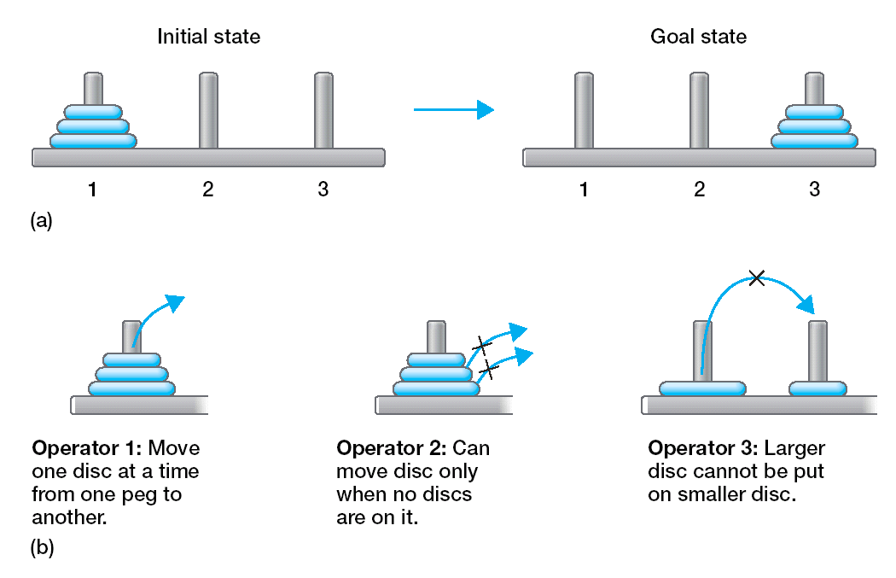

Slide 8
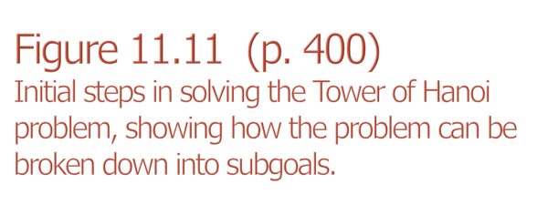
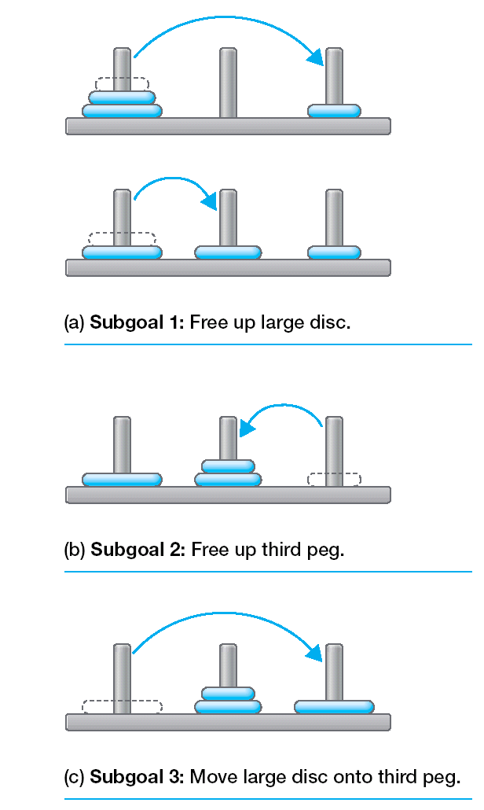

Slide 9
Sometimes it is not possible to be sure about the rules, the initial state, the operations, or even the goal of a problem; such a problem is described as ill defined.
A special case of an ill-defined problem is known as the insight problem, to which, despite all the unknowns, the answer seems to come all of a sudden in a flash of understanding.

Slide 10

Cut the cake in 8 pieces using 3 cuts

Slide 11

A woman has four pieces of chain, each piece has 3 links, she wants to join the pieces into a single closed chain (like a bracelet). How can she do this with only 3 openings and 3 closings of the links?

Slide 12
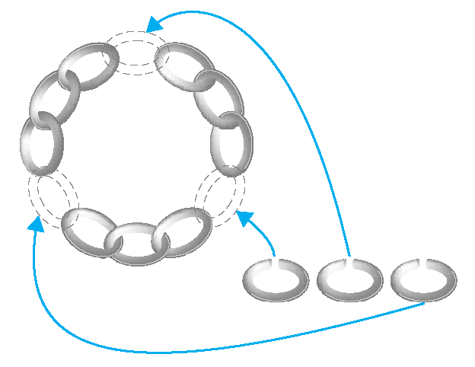
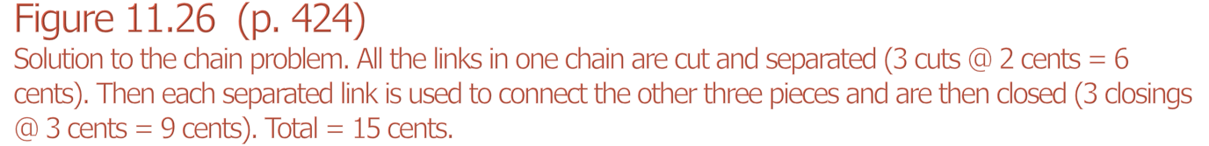

Slide 13

Connect the 9 dots with four contiguous lines - don’t pick up your pencil!
. . .
. . .
. . .

Slide 14

Name a commonly used four-letter word ending in E-N-Y

Slide 15

The only word in the English language that the letter “F” does not make a “ffff” sound.

Slide 16
Problem Space Theory
Today, the main theory underlying research on problem solving is problem space theory, developed by Allen Newell and Herbert Simon and described in their book, Human Problem Solving (1972).
Problem solving, in this view, is a search within a problem space, which is the set of states, or possible choices, that faces the problem solver at each step in moving from an initial state to a goal state.
The problem space includes the initial state, the goal state, and all possible intermediate states.

Slide 17

Problem space – set of states or choices from the initial state to the goal state
Search trees – a representation of the set of states that can be reached by applying operators to initial state

Slide 18
Why?!?
  Possible routes to solve the problem
  Shortest solution
  Errors people make

Slide 19
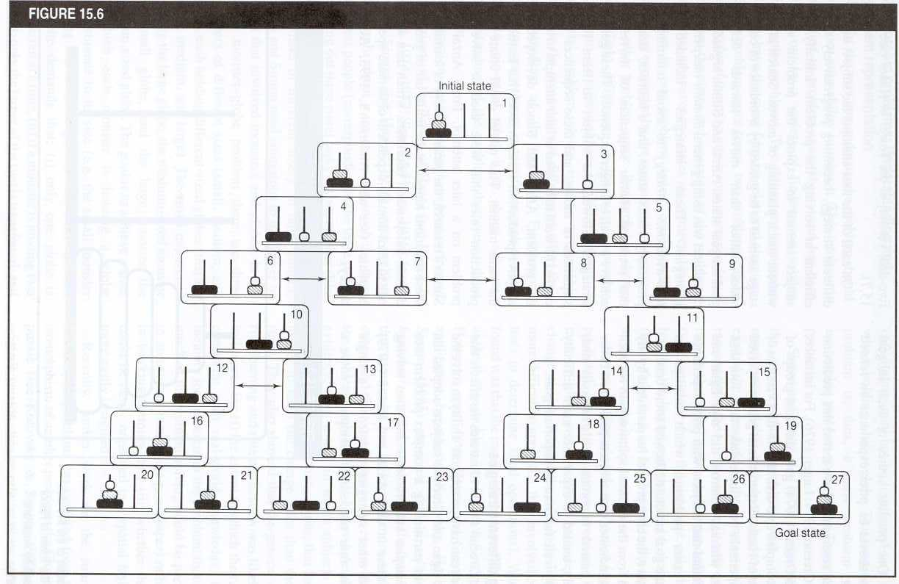
Slide 33

Slide 20

Cannot “see” entire problem space
Have limited selection of operators
Cannot move from any state to any other
  Limited by available operators

